Slide 1
Optimization in Application: Green Epichlorohydrin Plant Production
Tanner Street and Zack Horton
December 5th, 2023
Notes:
Tanner

Slide 2
Problem & Motivation
Data for Problem
Method to Solve
Key Findings
Conclusion
Notes:
Tanner

Slide 3
Problem
&
Motivation
ECH is a primary intermediate in epoxy resin production
ECH traditionally produced using propylene
Glycerol sustainable alternative (biodiesel byproduct)
Plant centered around dehydrochlorination reaction:
Motivation is to create a more sustainable, efficient solution that maximizes profit, adheres to chemical engineering principles, and environmental standards
Network representation of chemical plant
5 total materials 2 reactants 1 final product
Notes:
Tanner

Slide 4
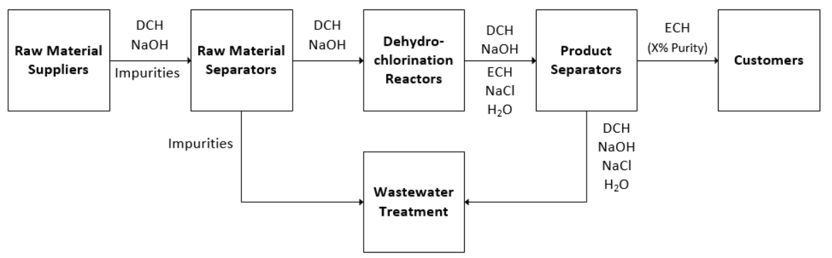
Block Flow Diagram
Notes:
Tanner

Slide 5
Data for Problem
Suppliers
Separators
Unit cost of purchasing
Varying levels of impurity
Supply of a specific raw material
Both fixed and unit cost
100% recovery for raw materials
Varying recoveries for product streams
Reactors
Customers
Both fixed and unit cost
Different conversion rates
Capacity of vessels
Unit revenue
Storage capacity
Purity requirement
Notes:
Tanner

Slide 6
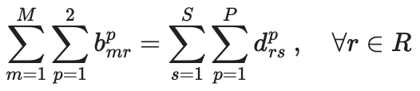
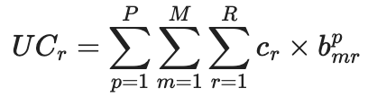
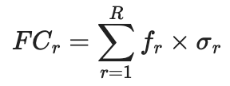
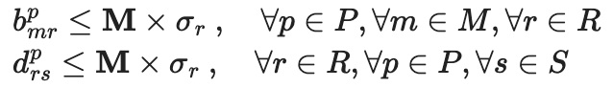
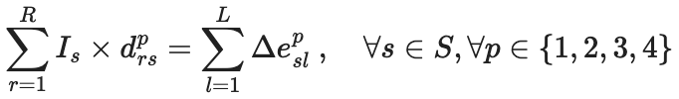
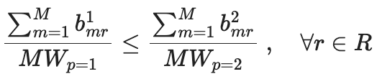
Method
to
Solve
Flow and Mass Conservation:
Costs:
Separator Recovery:
DCH Limiting Reactant:
1,138 constraints 470 continuous and 40 binary variables
Notes:
Zack

Slide 7
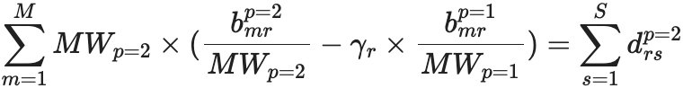
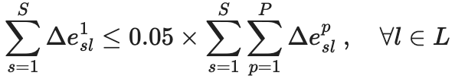
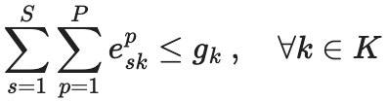
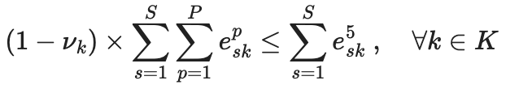
Method
to
Solve
NaOH Conversion:
Organic Waste Disposal:
Customer Demand:
1,138 constraints 470 continuous and 40 binary variables
Notes:
Zack

Slide 8
Key Findings
Financial Success
Option Utilization
Environmental Waste
$7.5M in Net Profit
$12.7M in Operating Cost
$20.2M in Sales Revenue
4 separators and 2 reactors used
1 customer at storage capacity
4 distinct suppliers
$774K in aqueous waste
$143K in organic waste
8K MT waste
Notes:
Zack

Slide 9
Impact
&
Conclusion
Maximize profit while maintaining sustainability
Future Plant Improvement: Recycle more material instead of sending to wastewater
Explore changes that allow scaling up to use all available capital
Conclusion: With optimization driven strategy, the plant is an environmentally and financially lucrative investment.
Optimization helps create sustainable and profitable solution
7.5M USD net profit
Notes:
Tanner

Slide 10
Thank you!
Questions?

Slide 11
Appendix Slides

Slide 12
Flow of Chemicals in Plant

Slide 13
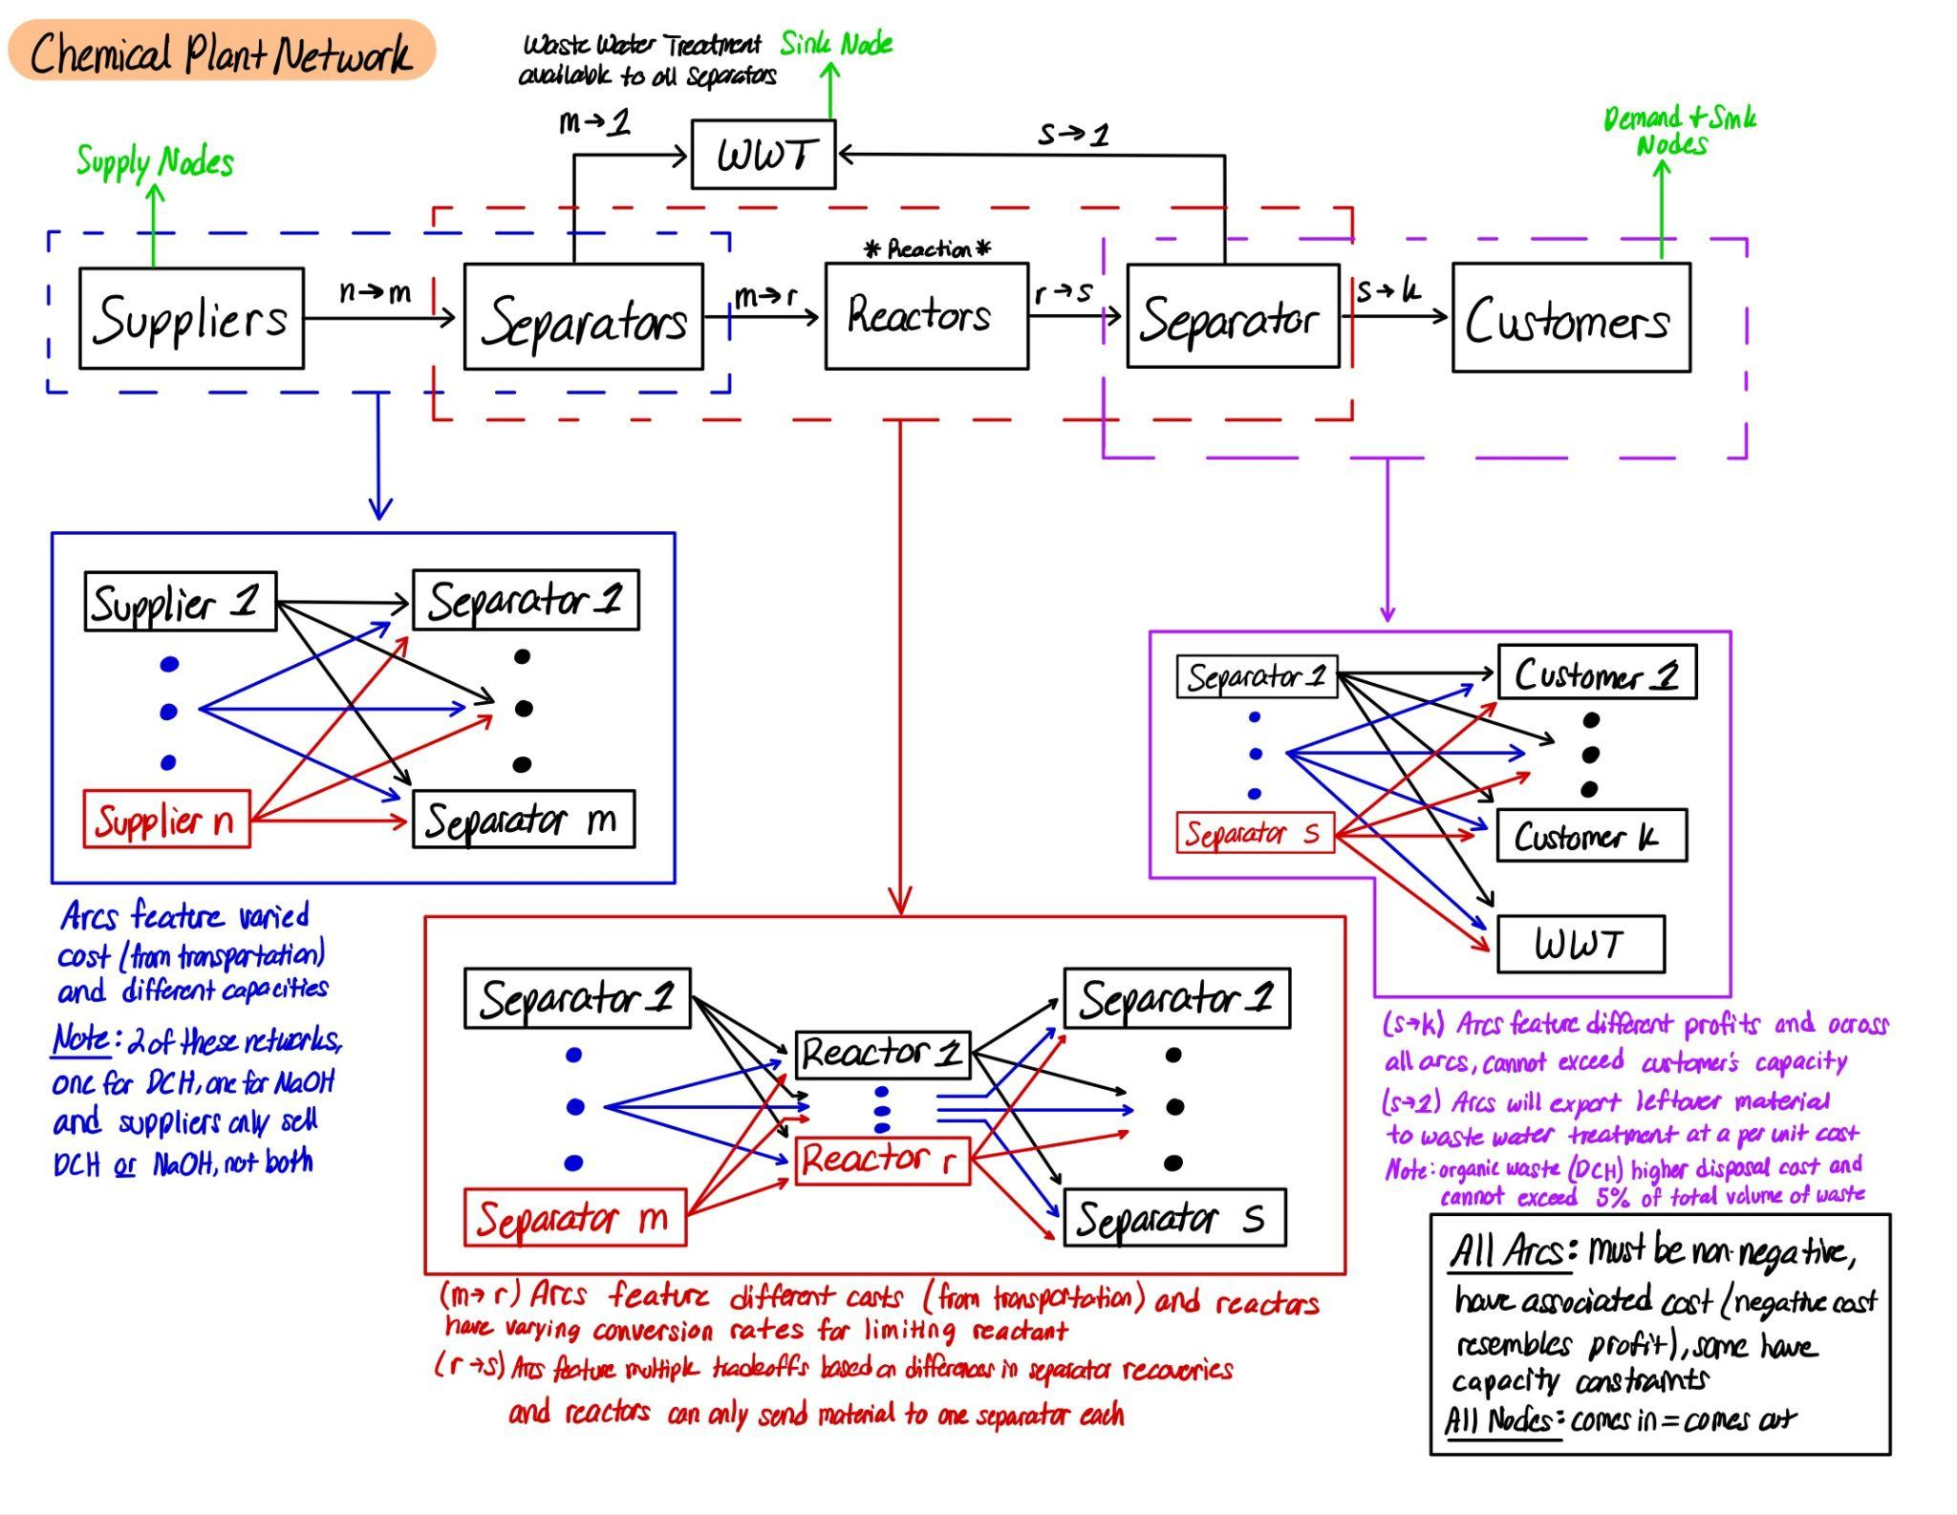
Network Representation of Chemical Plant

Slide 14
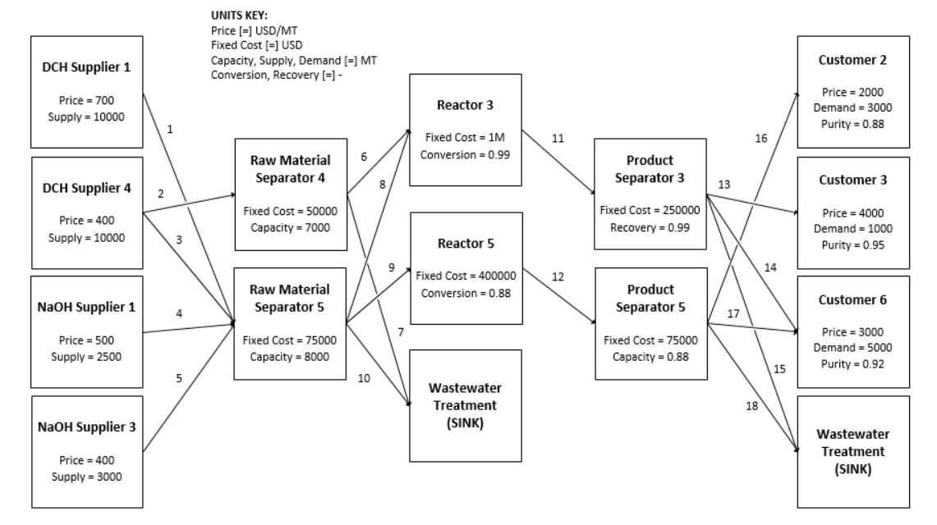
Solution

Slide 15
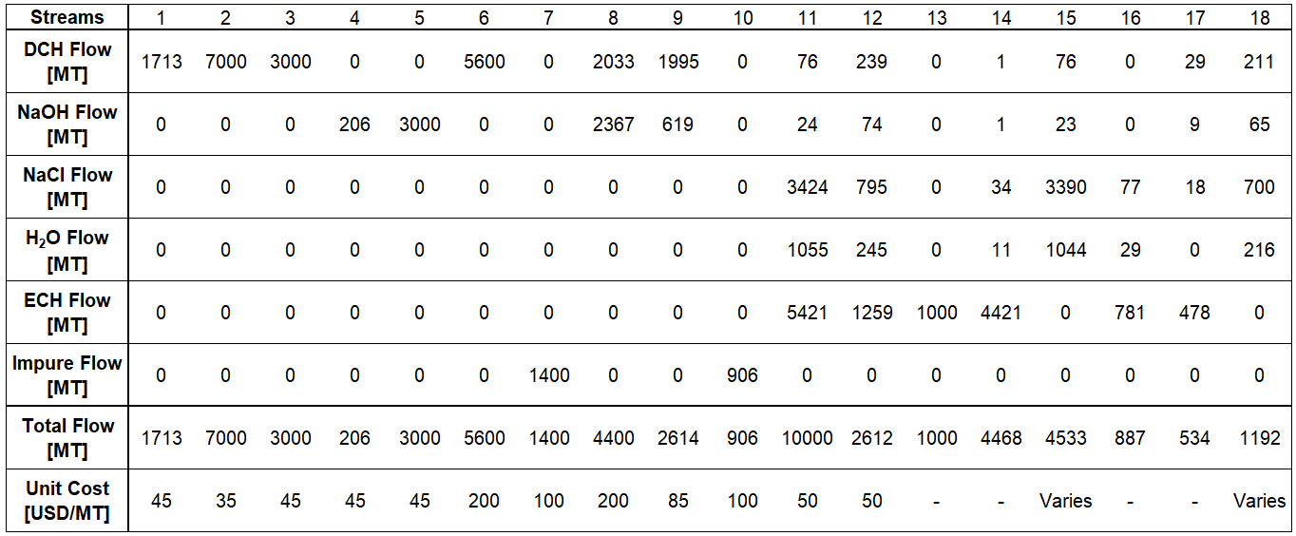
Solution

Slide 16
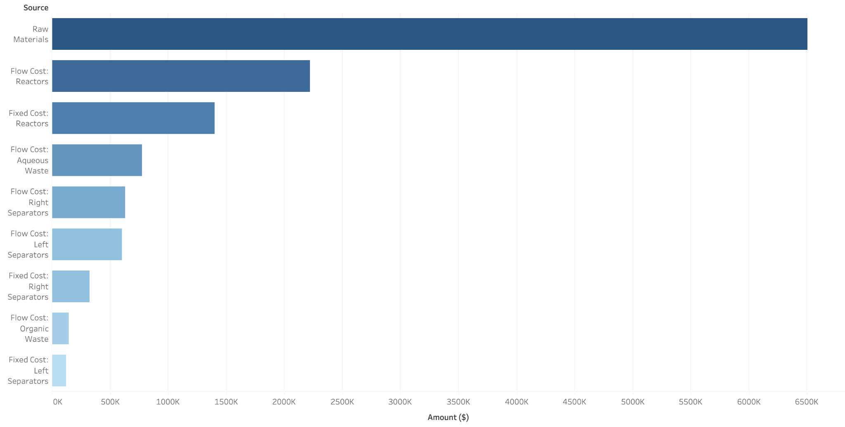
Solution

Slide 17
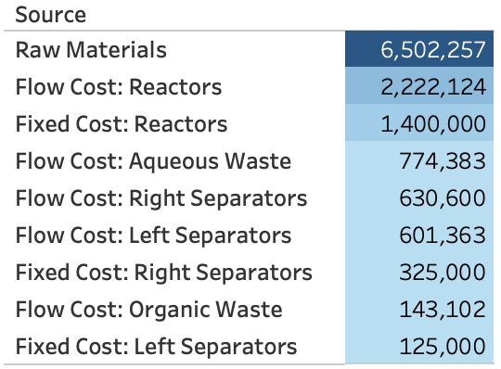
Cost Breakdown of Optimal Solution

Slide 18
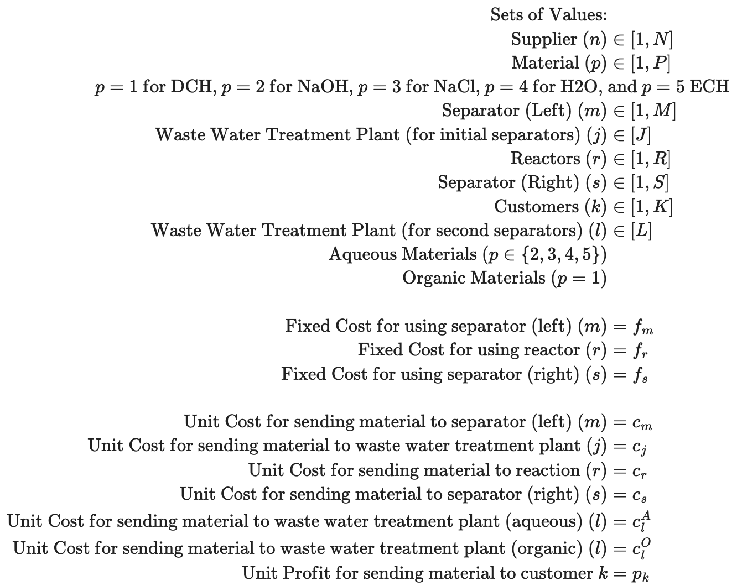
Sets and Ranges for Problem

Slide 19
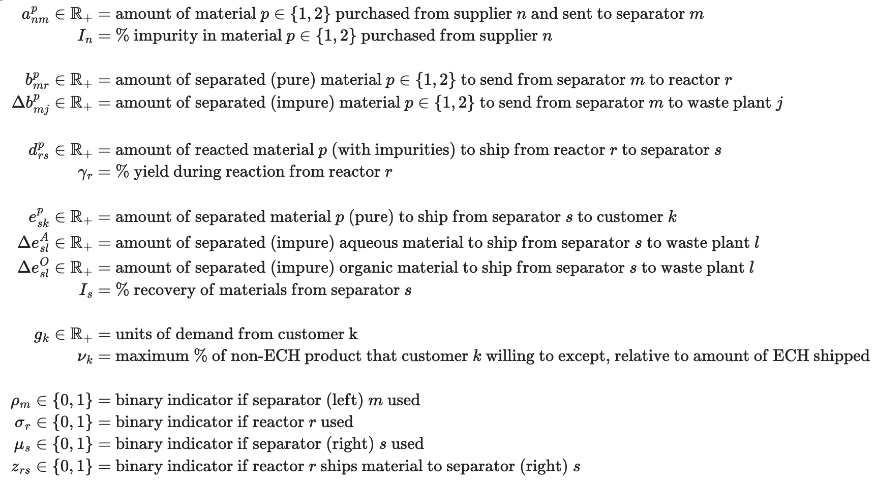
Variables in Model

Slide 20
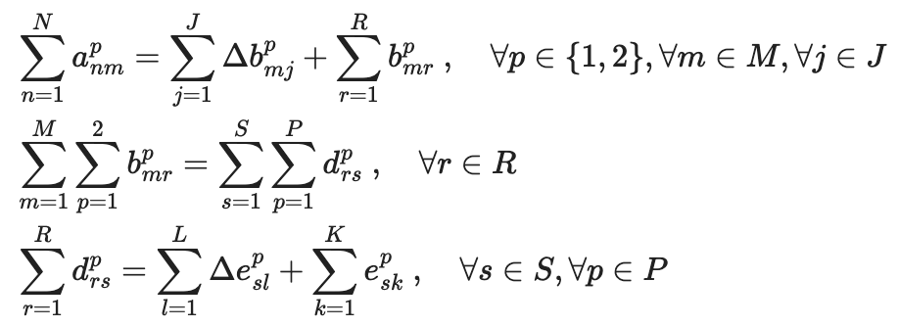
Conservation of Flow & Mass

Slide 21
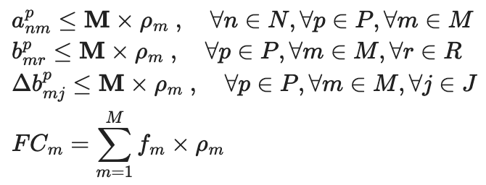
Fixed Cost for Primary (Left) Separators

Slide 22
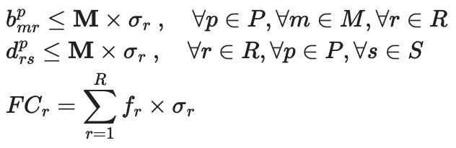
Fixed Cost for Reactors

Slide 23
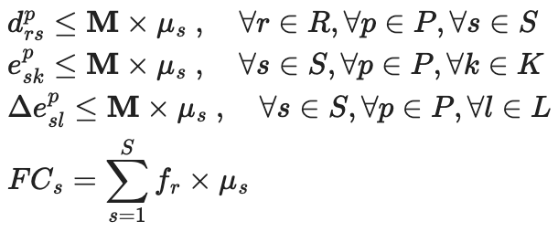
Fixed Cost for Secondary (Right) Separators

Slide 24
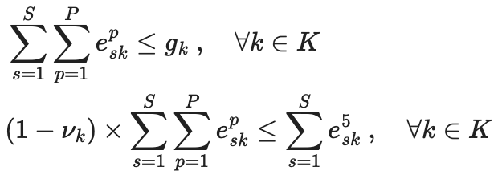
Customer Demand Constraints

Slide 25
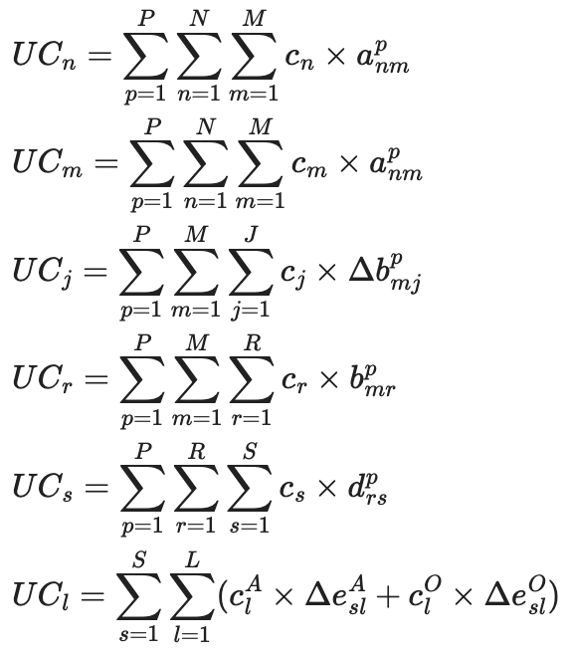
Unit Cost Calculations

Slide 26
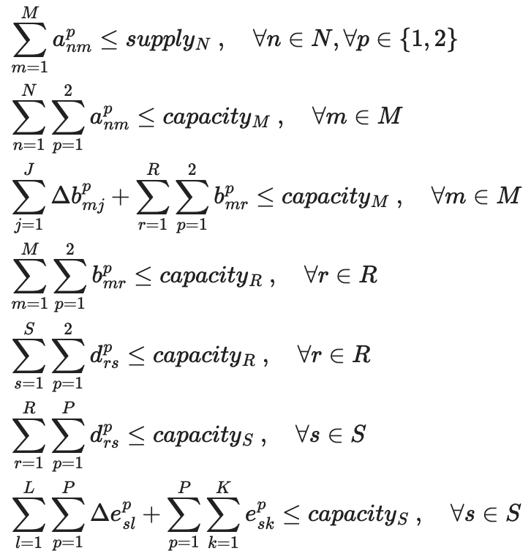
Arc Flow Capacities

Slide 27
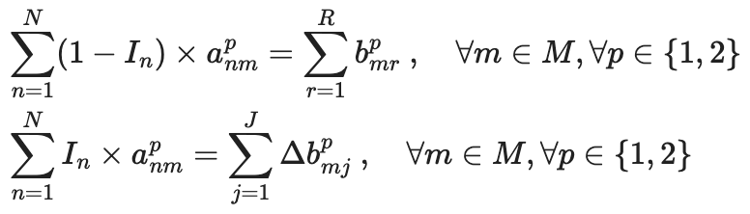
Recovery from Primary (Left) Separators

Slide 28
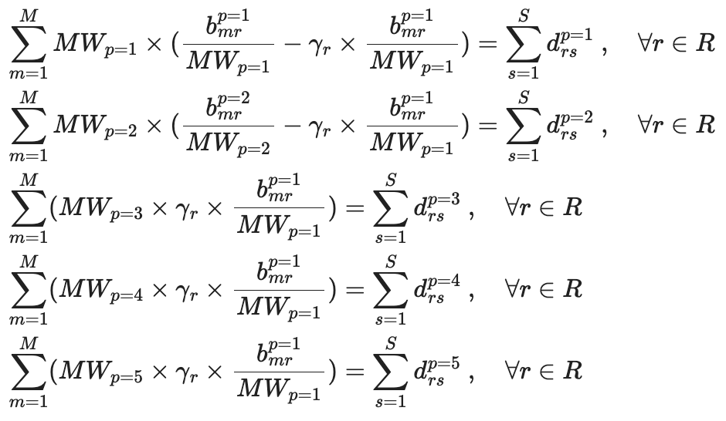
Chemical Conversion Calculations for Reactors

Slide 29
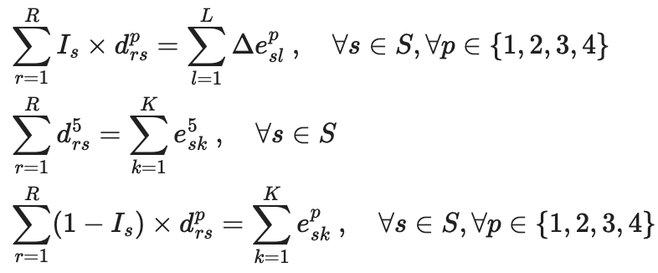
Recovery from Secondary (Right) Separators

Slide 30
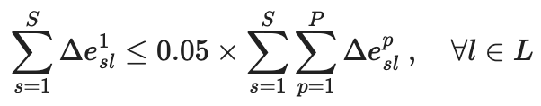
Requirements for Organic Waste Disposal

Slide 31
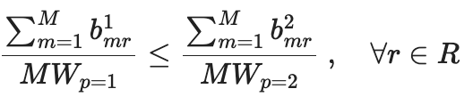
DCH (p=1) is the Limiting Reactant

Slide 32
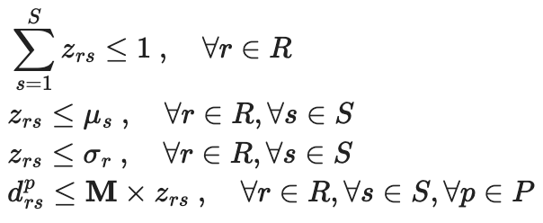
Rector Flow Remains Together

Slide 33
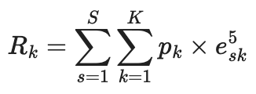
Revenue Calculation & Objective Function

